Slide 1
Students Performance in Exams
Presented By
Name : S Dineshkumar
College name : Jayaraj annapackiam CSI college of engineering
Department : Mechanical engineering

Slide 2
OUTLINE
Problem Statement
Proposed System/Solution
System Development Approach
Algorithm & Deployment
Result
Conclusion
Future Scope
References

Slide 3
Problem Statement
Individual Differences: Students exhibit diverse learning styles, cognitive abilities, and socio-economic backgrounds, which can influence their performance in exams. Understanding and accommodating these differences are essential for promoting equitable academic outcomes.
Teaching Methods and Curriculum Design: The effectiveness of teaching methods and curriculum design profoundly impacts students' exam performance. Pedagogical approaches that fail to engage students or align with their learning needs may hinder academic achievement.
Motivation and Engagement: Students' motivation and engagement levels play a pivotal role in their exam performance. Factors such as intrinsic motivation, interest in the subject matter, and perceived relevance of exams to future goals significantly influence students' effort and performance.
Assessment Practices: The design and implementation of exams greatly affect students' performance. Issues such as test format, clarity of instructions, and alignment with learning objectives can either facilitate or impede students' ability to demonstrate their knowledge and skills effectively.
External Factors: Beyond the classroom, external factors such as family support, peer relationships, socioeconomic status, and access to resources can impact students' exam performance. Addressing disparities in these areas is crucial for promoting educational equity.

Slide 4
Proposed Solution
Implement individualized learning plans based on students' diverse learning styles, abilities, and interests.
Utilize diagnostic assessments to identify students' strengths and areas for growth, enabling targeted interventions. Provide differentiated instruction and enrichment activities to cater to varying academic needs within the classroom.
Employ interactive teaching methods, such as project-based learning, cooperative learning, and experiential activities, to enhance student engagement.
Incorporate multimedia resources, educational technology, and real-world examples to make learning relevant and stimulating.
Foster a supportive and inclusive classroom environment where students feel valued, respected, and motivated to excel.
Integrate formative assessment strategies, such as regular quizzes, peer feedback, and self-assessment, to monitor student progress and provide timely feedback.
Use formative assessment data to identify misconceptions, adjust instruction, and tailor interventions to address individual learning needs.
Encourage student reflection on their learning journey, empowering them to take ownership of their academic growth.
Provide ongoing professional development opportunities for educators to enhance their instructional practices, assessment literacy, and cultural competency.
Foster a culture of collaboration and innovation among faculty members, encouraging the sharing of best practices and the adoption of evidence-based strategies

Slide 5
System Approach
Analyze curriculum standards, learning objectives, and instructional materials to ensure alignment with exam expectations.
Incorporate interdisciplinary connections, real-world relevance, and opportunities for inquiry-based learning to enhance student engagement and comprehension.
Regularly review and revise the curriculum to address evolving educational needs and emerging trends in assessment practices.
Provide professional development opportunities for educators to enhance their pedagogical skills, content knowledge, and instructional strategies.
Promote evidence-based teaching practices, such as differentiated instruction, active learning, and scaffolding techniques, to meet the diverse needs of students.
Foster a culture of collaboration and reflective practice among teachers, encouraging peer observations, feedback exchanges, and instructional innovation.
Provide comprehensive support services, including academic advising, counseling, tutoring, and enrichment programs, to address the diverse needs of students.
Implement interventions to support students at risk of academic underachievement, such as early intervention programs, mentorship initiatives, and academic support groups. Collaborate with parents, guardians, and community organizations to create a network of support that extends beyond the classroom and promotes student success.

Slide 6
Algorithm & Deployment
Algorithm Development
Gather data on student demographics, academic records, exam scores, and attendance records.
Determine key performance indicators (KPIs) such as average exam scores, pass rates, and grade distribution across subjects and student demographics.
Cleanse and preprocess the data to handle missing values, outliers, and inconsistencies.
Conduct EDA to uncover patterns, trends, and correlations in the data.
Identify factors such as socio-economic status, previous academic performance, and attendance that may influence exam outcomes.
Select relevant features that are strongly correlated with exam performance based on EDA findings.
Choose appropriate machine learning algorithms such as regression, classification, or ensemble methods to predict students' exam performance.
Split the data into training and testing sets for model evaluation.
Train the model on the training data and optimize hyperparameters using techniques such as crossvalidation. Evaluate the model's performance on the testing data using metrics such as accuracy, precision, recall, and F1-score.

Slide 7
Deployment
Engage key stakeholders including teachers, administrators, students, parents, and community members in the deployment process.
Communicate the objectives, benefits, and expected outcomes of the performance improvement system.
Ensure the necessary infrastructure and resources are in place, including hardware, software, and data management systems.
Collaborate with IT departments to set up databases, analytics tools, and communication platforms for data collection, analysis, and reporting.
Provide training sessions for teachers and staff on how to use the performance improvement system effectively.
Offer professional development workshops on data analysis, intervention strategies, and best practices in student support
Integrate data sources such as student records, exam scores, attendance data, and socio-economic information into the performance improvement system.
Automate data collection, preprocessing, and analysis processes to streamline workflows and minimize manual effort.
Deploy machine learning models and algorithms developed for analyzing students' performance in exams.
Integrate predictive analytics and decision support tools into existing educational software platforms or dashboards for easy access by teachers and administrators.

Slide 8
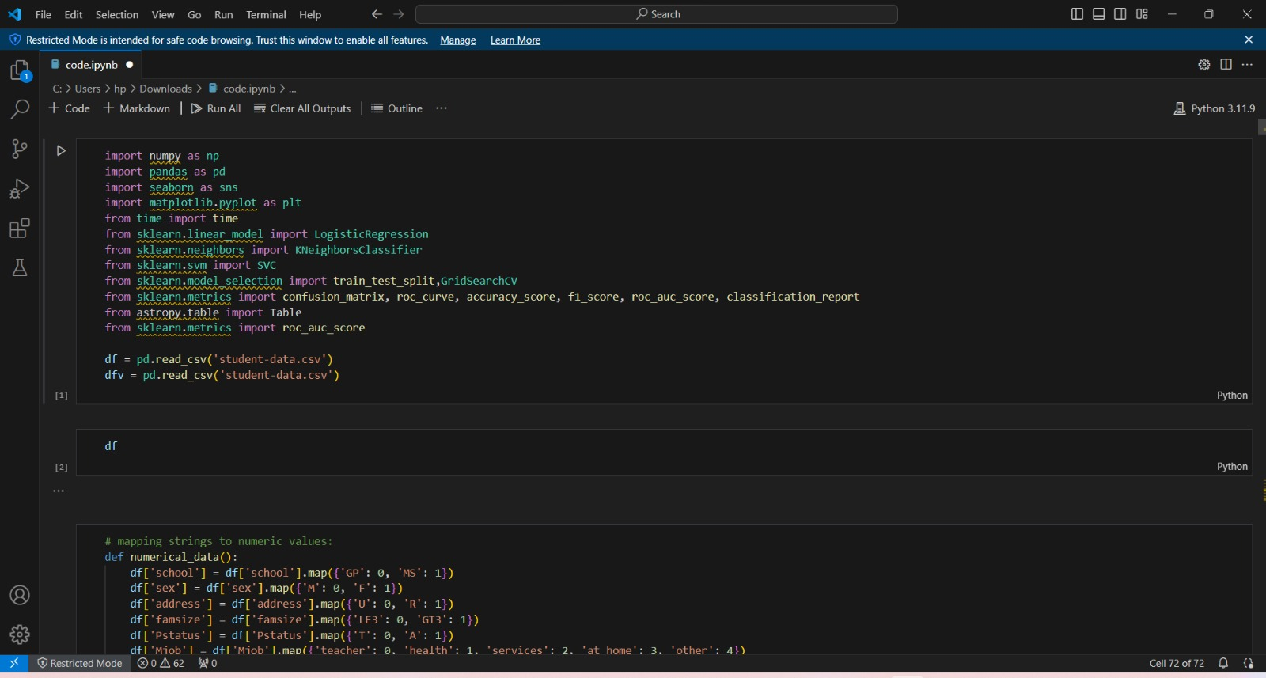



Result

Slide 9
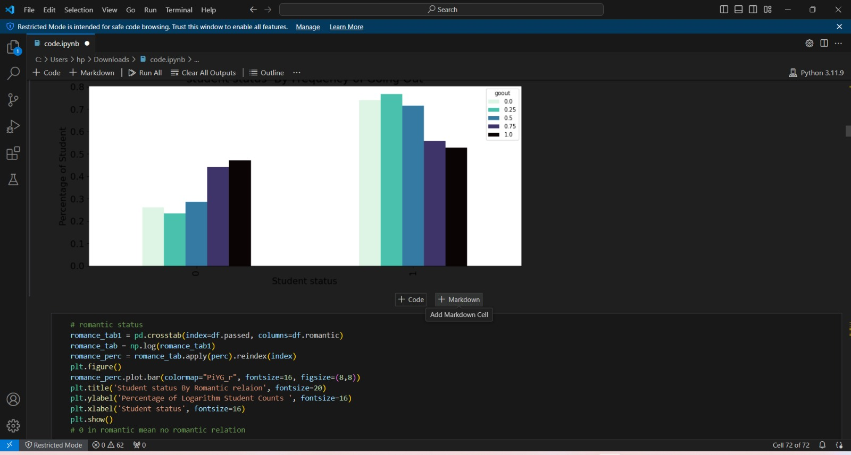

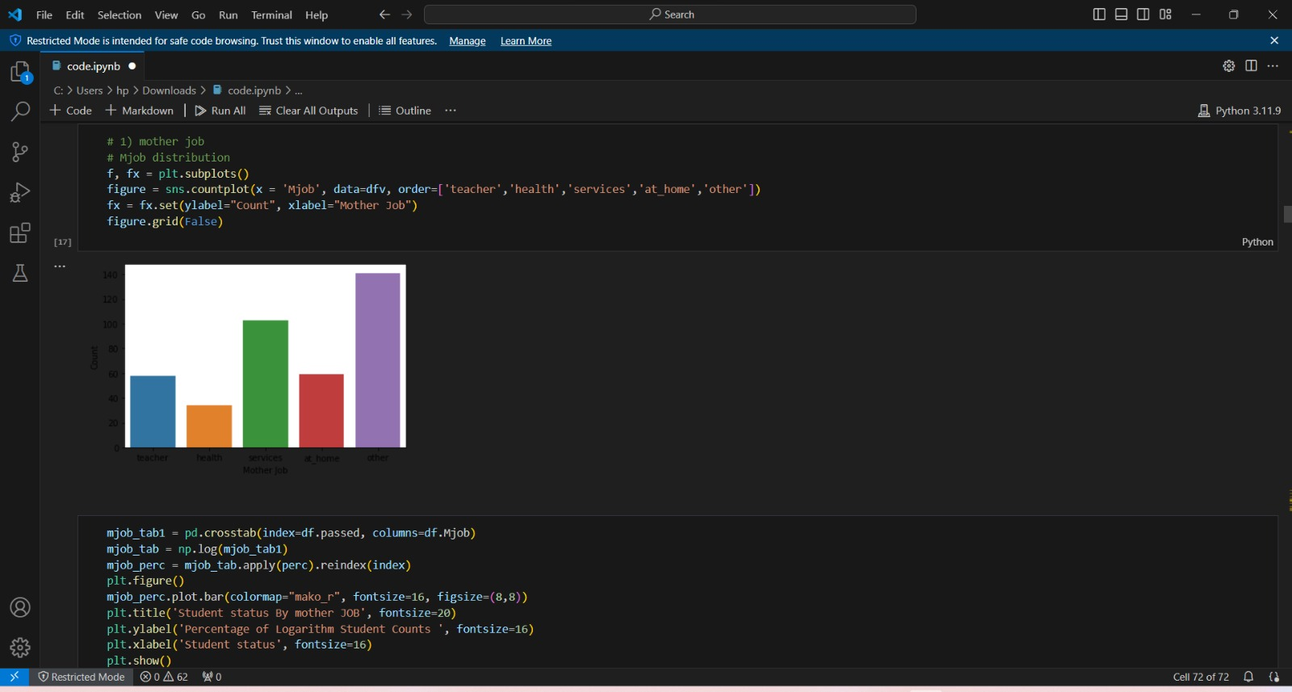


Slide 10
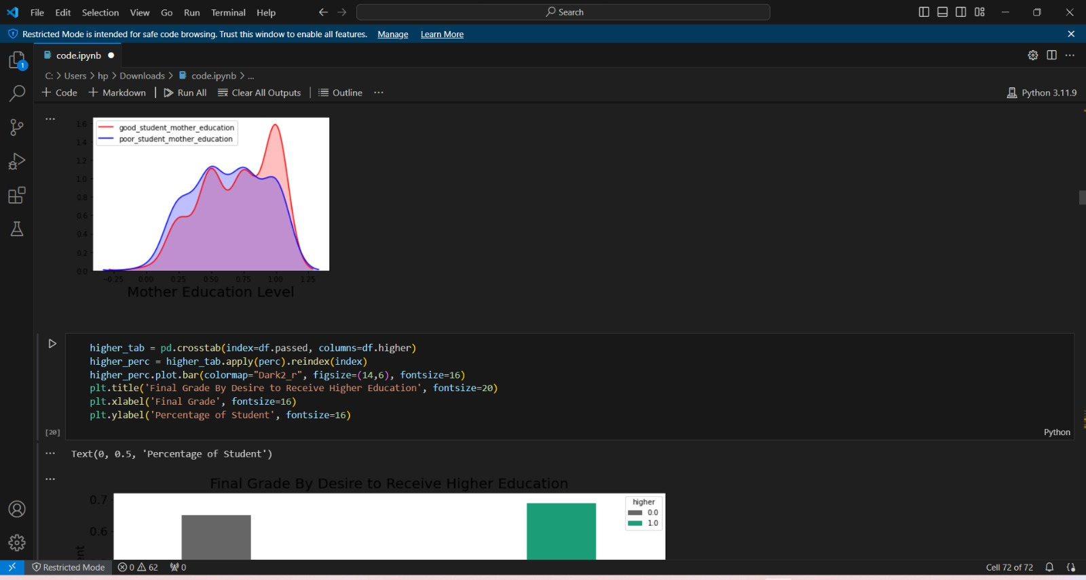
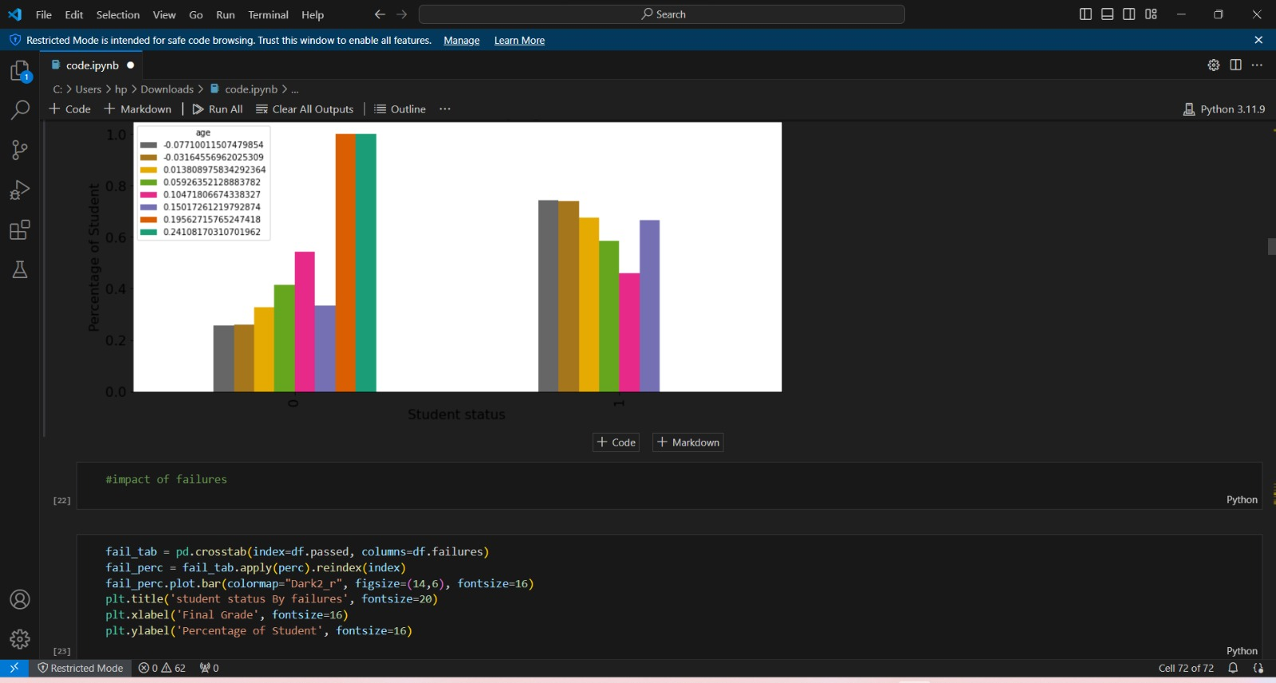

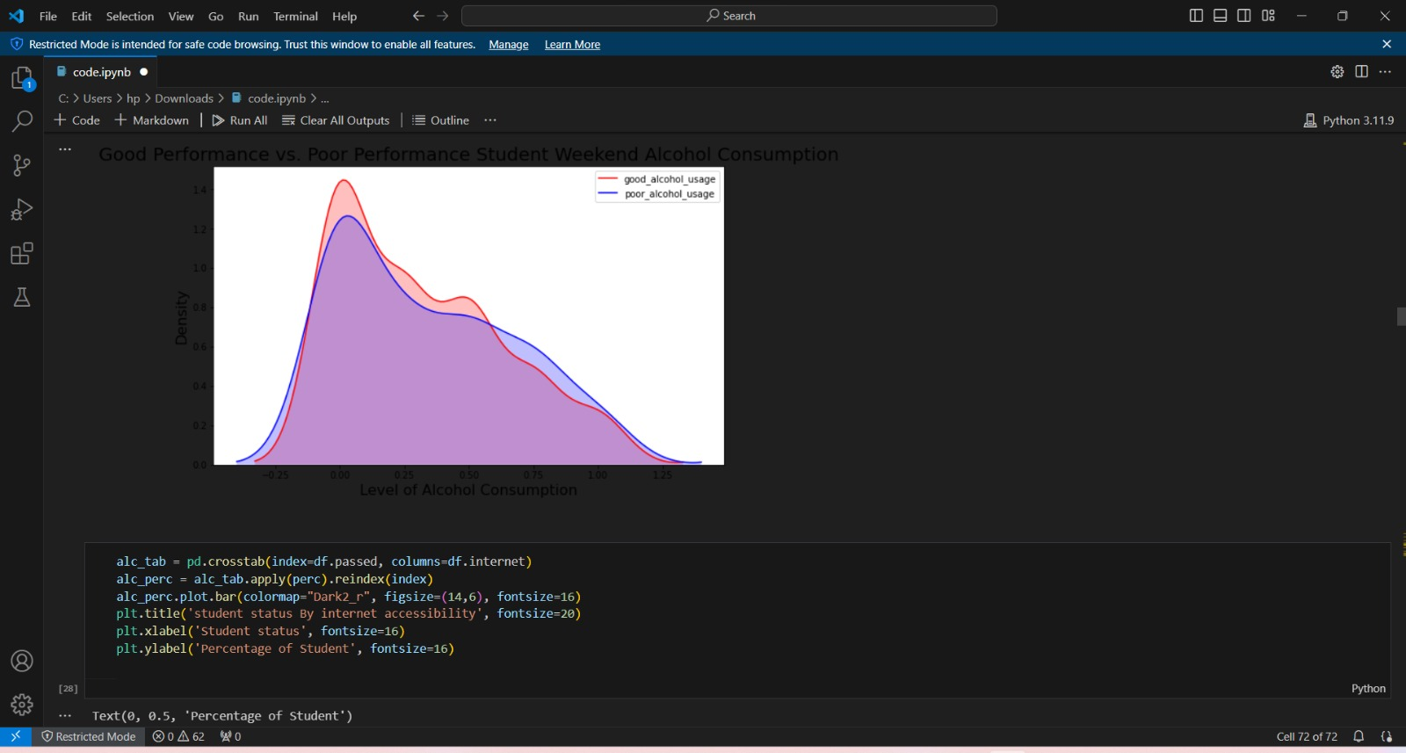

Slide 11


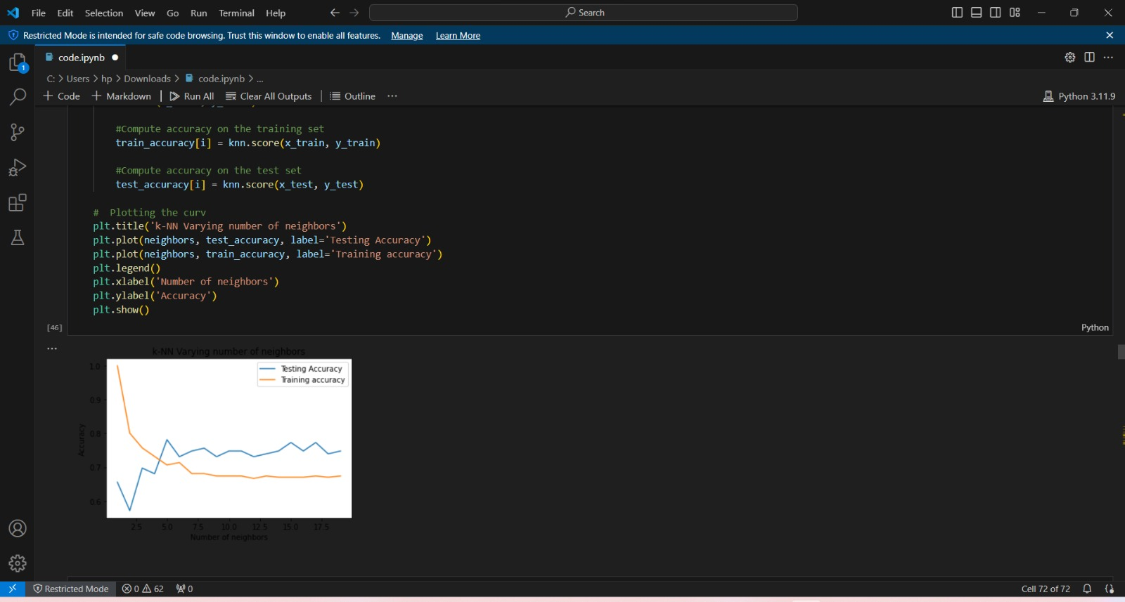

Slide 12
Conclusion
In conclusion, enhancing students' performance in exams is a multifaceted ende approach encompassing various factors within the educational system.
Through targeted interventions, and collaborative efforts, educational institutions can fos conducive to academic success for all students.
Key aspects of improving students' performance in exams include personalized pedagogy, effective assessment practices, comprehensive support services, and development for educators.
By addressing these components systematically and empower students to excel academically and achieve their full potential. Moreover, deploying systems and strategies for improving students' exam perfo engagement, infrastructure setup, training, data integration, intervention implemfeedback mechanisms.
By following a structured deployment plan and fostering improvement, educational institutions can create sustainable pathways to succes Ultimately, by prioritizing data-informed decision-making, collaboration, and tr cultivate an environment where every student receives the support they need to succeed in exams. Through collective efforts and a commitment to excellence, wfuture for the next generation of learners.

Slide 13
Future scope
Personalized Learning Technologies: Advancements in technology, including artificial intelligence and machine learning, will enable the development of personalized learning platforms tailored to individual student needs. These platforms can dynamically adapt instruction, provide targeted feedback, and offer customized learning pathways to optimize exam performance.
Data Analytics and Predictive Modeling: Continued advancements in data analytics and predictive modeling techniques will enhance our ability to identify early indicators of academic risk and proactively intervene to support students before they experience academic challenges. Predictive analytics can help educators anticipate students' needs and provide timely interventions to improve exam outcomes.
Virtual and Augmented Reality Learning Environments: Virtual and augmented reality technologies will revolutionize the way students engage with educational content, providing immersive learning experiences that enhance understanding and retention. These technologies can simulate real-world scenarios, facilitate hands-on learning, and provide interactive feedback to improve exam performance.
Gamification and Game-Based Learning: Gamification principles and game-based learning strategies will continue to gain prominence as effective tools for motivating students, increasing engagement, and fostering deeper learning. Gamified educational platforms can incentivize exam preparation, encourage mastery of subject matter, and promote collaborative problem-solving skills.
Social and Emotional Learning (SEL) Integration: There will be a growing emphasis on integrating social and emotional learning (SEL) into academic curriculum to support students' holistic development and wellbeing. SEL programs can help students develop resilience, self-regulation, and interpersonal skills, which are critical for academic success and exam performance.
Equity and Inclusion Initiatives: Efforts to promote equity and inclusion in education will remain a central focus, with initiatives aimed at addressing disparities in exam performance among students from diverse backgrounds.

Slide 14
References
Hattie, J., & Timperley, H. (2007). The power of feedback. Review of Educational Research, 77(1), 81-112.
Zimmerman, B. J. (2008). Investigating self-regulation and motivation: Historical background, methodological developments, and future prospects. American Educational Research Journal, 45(1), 166-183.
OECD. (2019). PISA 2018 Results (Volume I): What Students Know and Can Do. Paris: OECD Publishing.
National Research Council. (2001). Knowing what students know: The science and design of educational assessment. National Academies Press.Black, P., & Wiliam, D. (1998). Inside the black box: Raising standards through classroom assessment. Phi Delta Kappan, 80(2), 139-148.
Crede, M., & Kuncel, N. R. (2008). Study habits, skills, and attitudes: The third pillar supporting collegiate academic performance. Perspectives on Psychological Science, 3(6), 425-453.
Marsh, H. W., & Hau, K. T. (2004). Explaining paradoxical relations between academic self‐concepts and achievements: Cross‐cultural generalizability of the internal/external frame of reference predictions across 26 countries. Journal of Educational Psychology, 96(1), 56-67.
Duckworth, A. L., & Seligman, M. E. (2006). Self-discipline gives girls the edge: Gender in self-discipline, grades, and achievement test scores. Journal of Educational Psychology, 98(1), 198-208.
Steele, C. M. (1997). A threat in the air: How stereotypes shape intellectual identity and performance. American Psychologist, 52(6), 613-629.
Dweck, C. S. (2006). Mindset: The new psychology of success. Random House.

Slide 15
THANK YOU

